Slide 2
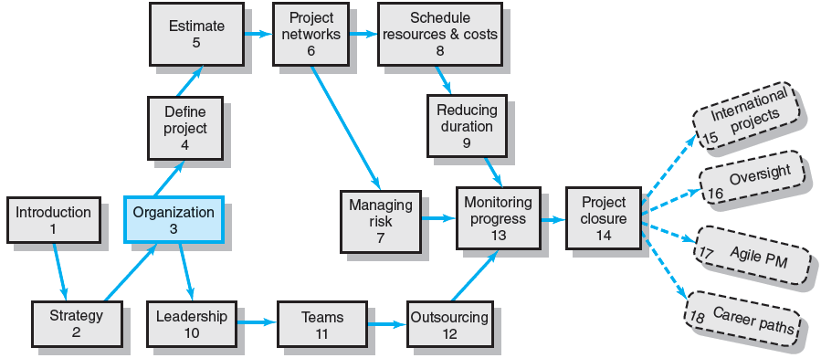
Where We Are Now

Slide 3
Chapter Objectives
To be able to identify different types of project management structures
To understand the strengths and weaknesses of different project management structures
To appreciate the significance that organizational culture plays in managing projects
To be able to interpret the culture of an organization
To understand the interaction between project management structure and the culture of an organization.

Slide 4
Project Management Structures
Challenges to Organizing Projects
The uniqueness and short duration of projects relative to ongoing longer-term organizational activities
The multidisciplinary and cross-functional nature of projects creates authority and responsibility dilemmas.
Choosing an Appropriate Project Management Structure
The best system balances the needs of the project with the needs of the organization.

Slide 5
Project Management Structures (cont’d)
Organizing Projects: Functional organization
Different segments of the project are delegated to respective functional units.
Coordination is maintained through normal management channels.
Used when the interest of one functional area dominates the project or one functional area has a dominant interest in the project’s success.

Slide 6
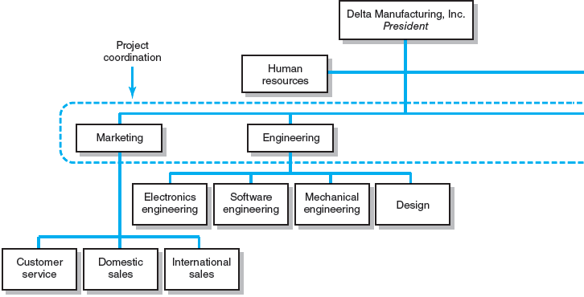
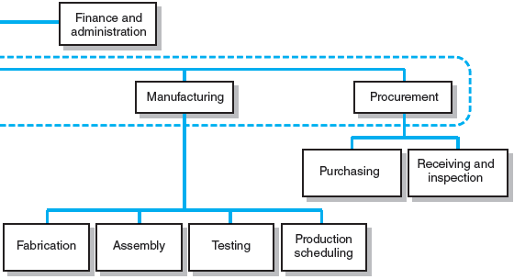
Functional Organizations
FIGURE 3.1

Slide 7
Functional Organization of Projects
Advantages
No structural change
Flexibility
In-depth expertise
Easy post-project transition
Disadvantages
Lack of focus
Poor integration
Slow
Lack of ownership

Slide 8
Project Management Structures (cont’d)
Organizing Projects: Dedicated Teams
Teams operate as separate units under the leadership of a full-time project manager.
In a projectized organization where projects are the dominant form of business, functional departments are responsible for providing support for its teams.

Slide 9
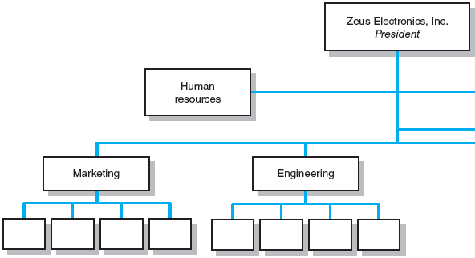
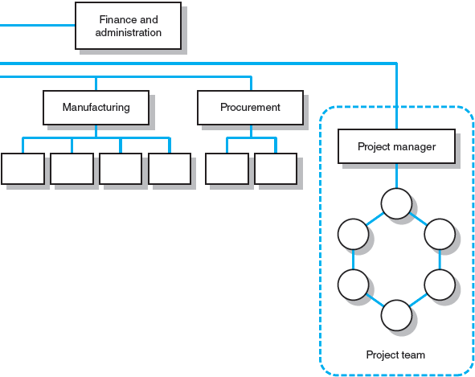
Dedicated Project Team
FIGURE 3.2

Slide 10
Project Organization: Dedicated Team
Advantages
Simple
Fast
Cohesive
Cross-Functional Integration
Disadvantages
Expensive
Internal Strife
Limited Technological Expertise
Difficult Post-Project Transition

Slide 11
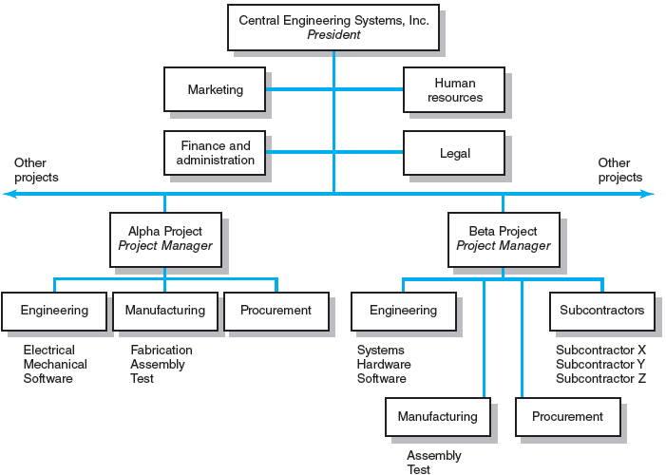
Projectized Organizational Structure
FIGURE 3.3

Slide 12
Project Management Structures (cont’d)
Organizing Projects: Matrix Structure
Hybrid organizational structure (matrix) is overlaid on the normal functional structure.
Two chains of command (functional and project)
Project participants report simultaneously to both functional and project managers.
Matrix structure optimizes the use of resources.
Allows for participation on multiple projects while performing normal functional duties.
Achieves a greater integration of expertise and project requirements.

Slide 13
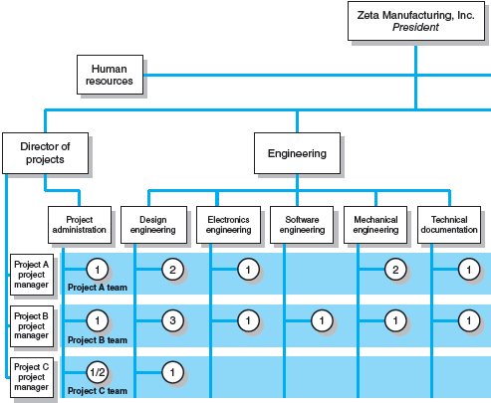
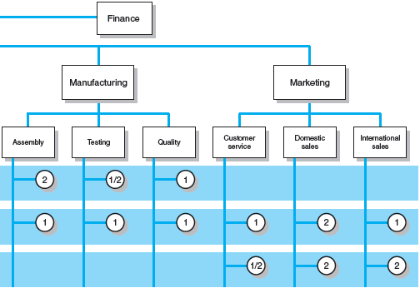
Matrix Organization Structure
FIGURE 3.4

Slide 14
Division of Project Manager and Functional Manager Responsibilities in a Matrix Structure
Project Manager Negotiated Issues Functional Manager
What has to be done? Who will do the task? How will it be done?
When should the task be done? Where will the task be done?
How much money is available Why will the task be done? How will the project involvement to do the task? impact normal functional activities?
How well has the total project Is the task satisfactorily How well has the functional been done? completed? input been integrated?
TABLE 3.1

Slide 15
Different Matrix Forms
Weak Form
The authority of the functional manager predominates and the project manager has indirect authority.
Balanced Form
The project manager sets the overall plan and the functional manager determines how work to be done.
Strong Form
The project manager has broader control and functional departments act as subcontractors to the project.

Slide 16
Project Organization: Matrix Form
Advantages
Efficient
Strong Project Focus
Easier Post-Project Transition
Flexible
Disadvantages
Dysfunctional Conflict
Infighting
Stressful
Slow

Slide 17
What Is the Right Project Management Structure?
Organization (Form) Considerations
How important is the project to the firm’s success?
What percentage of core work involves projects?
What level of resources (human and physical) are available?

Slide 18
What Is the Right Project Management Structure? (cont’d)
Project Considerations
Size of project
Strategic importance
Novelty and need for innovation
Need for integration (number of departments involved)
Environmental complexity (number of external interfaces)
Budget and time constraints
Stability of resource requirements

Slide 19
Organizational Culture
Organizational Culture Defined
A system of shared norms, beliefs, values, and assumptions which bind people together, thereby creating shared meanings.
The “personality” of the organization that sets it apart from other organizations.
Provides a sense of identify to its members.
Helps legitimize the management system of the organization.
Clarifies and reinforces standards of behavior.

Slide 20
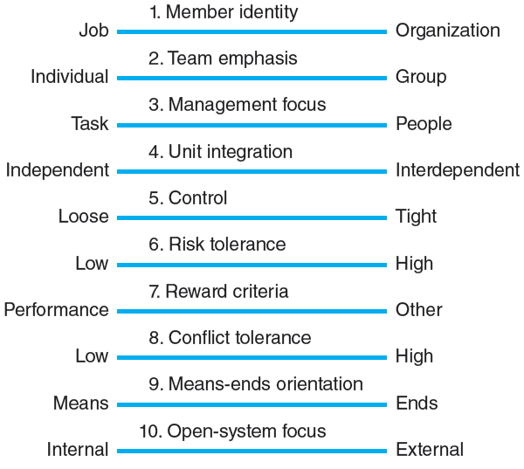
Key Dimensions Defining an Organization’s Culture
FIGURE 3.5

Slide 21
Identifying Cultural Characteristics
Study the physical characteristics of an organization.
Read about the organization.
Observe how people interact within the organization.
Interpret stories and folklore surrounding the organization.

Slide 22
Organizational Culture Diagnosis Worksheet
Power Corp.
I. Physical Characteristics:
Architecture, office layout, décor, attire
Corporate HQ is 20 Story modern building—president on top floor. Offices are bigger in the top floors than lower floors. Formal business attire (white shirts, ties, power suits, . . . ) Power appears to increase the higher up you are.
II. Public Documents:
Annual reports, internal newsletters, vision statements
At the heart of the Power Corp. Way is our vision . . . to be the global energy company most admired for its people, partnership and performance. Integrity. We are honest with others and ourselves. We meet the highest ethical standards in all business dealings. We do what we say we will do.
III. Behavior:
Pace, language, meetings, issues discussed, decision-making style, communication patterns, rituals
Hierarchical decision-making, pace brisk but orderly, meetings start on time and end on time, subordinates choose their words very carefully when talking to superiors, people rarely work past 6:00 P.M., president takes top performing unit on a boat cruise each year . . .
IV. Folklore:
Stories, anecdotes, heroines, heroes, villains
Young project manager was fired after going over his boss’s head to ask for additional funds.
Stephanie C. considered a hero for taking complete responsibility for a technical error.
Jack S. was labeled a traitor for joining chief competitor after working for Power Corp. for 15 years.
FIGURE 3.6

Slide 23
Implications of Organizational Culture for Organizing Projects
Challenges for Project Managers in Navigating Organizational Cultures
Interacting with the culture and subcultures of the parent organization
Interacting with the project’s clients or customer organizations
Interacting with other organizations connected to the project

Slide 24
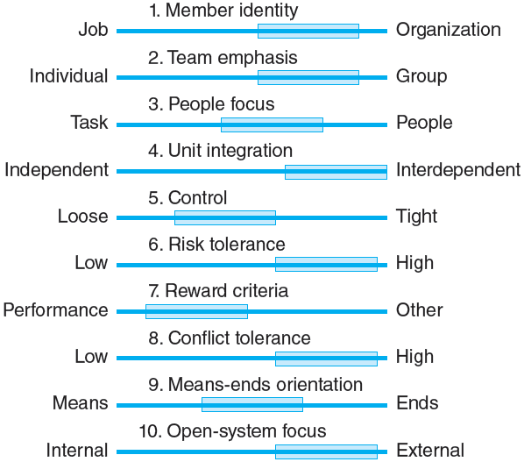
Cultural Dimensions of an Organization Supportive of Project Management
FIGURE 3.7

Slide 25
Key Terms
Balanced matrix
Dedicated project team
Matrix
Organizational culture
Projectized organization
Project Office (PO)
Strong matrix
Weak matrix

